Slide 1
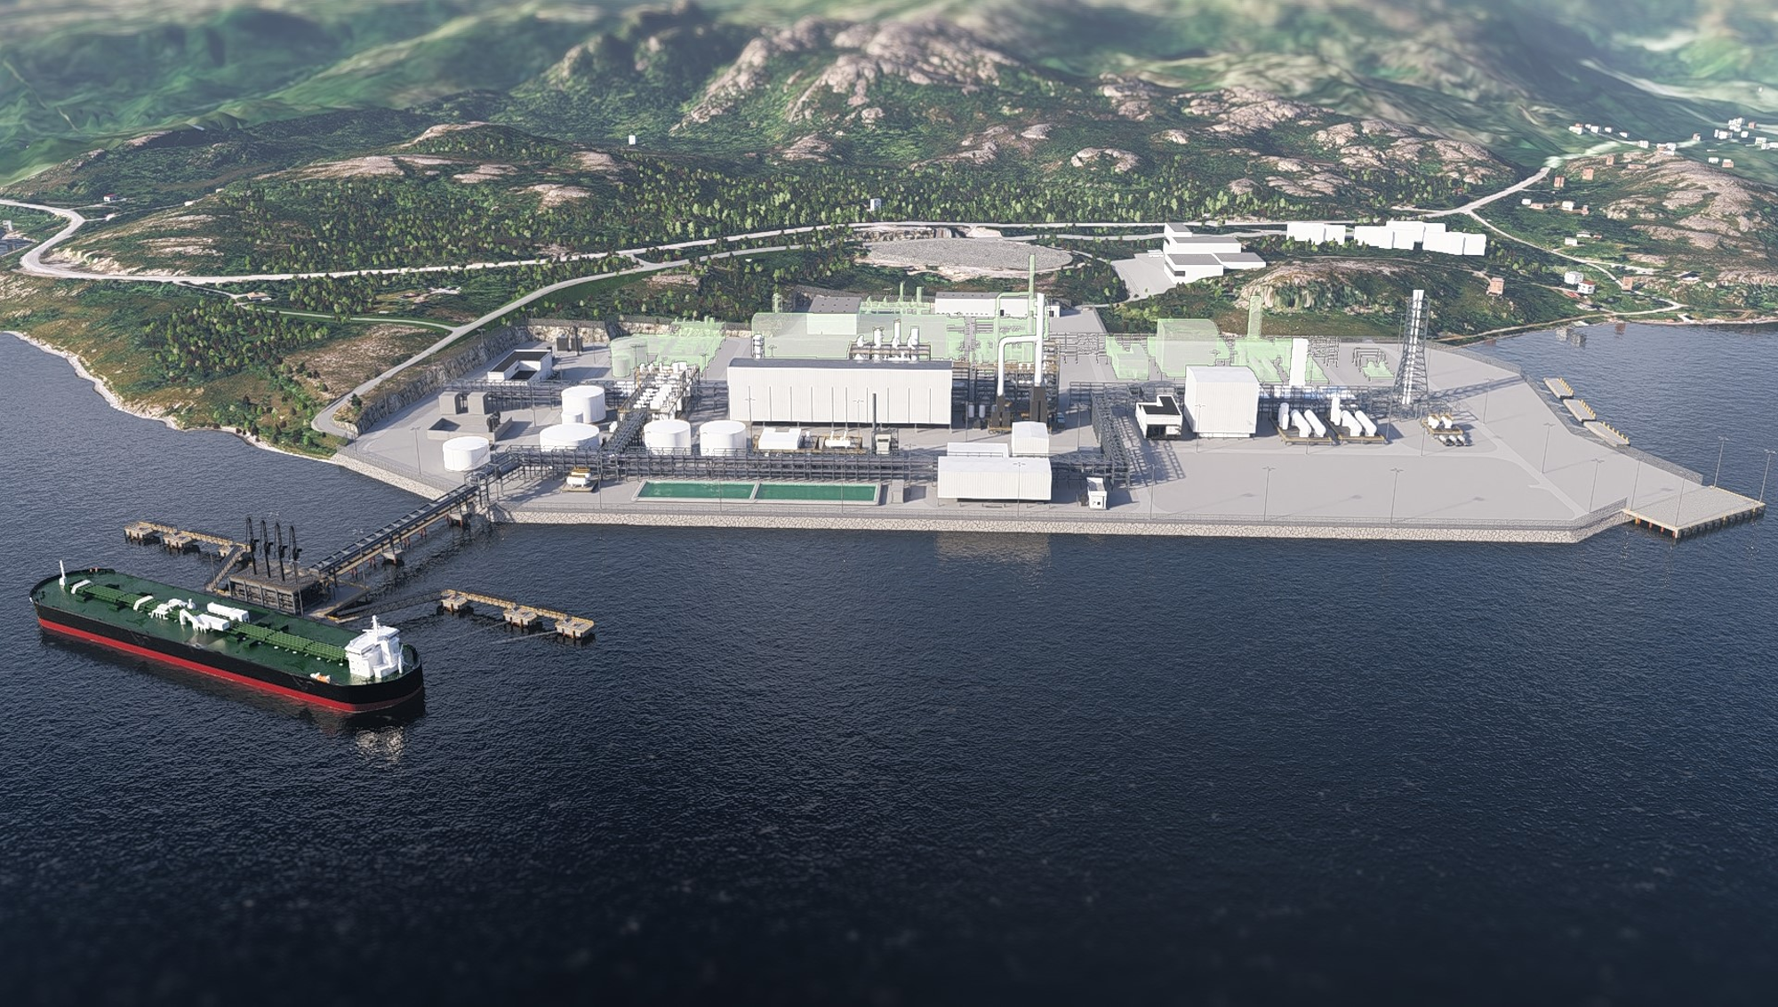

Barents Blue | Investor presentation
FEED ready world-class clean ammonia asset at key value inflection point
NOK 38.5 million SLIP with planned IPO in 2027
October 2026

Slide 2
SLIP investment highlights
90% derisking & FEED ready project
Most of the derisking already performed, project ready to proceed towards financial close.
The only world-scale low carbon ammonia asset in Europe, EBITDA above EUR 300 million.
Financial close planned in Q4 27¹/Q1 28, key milestone and strong value driver.
Commercially advanced and well-positioned
Commercial agreements signed² at priced term-sheet level, offering a well documented and attractive business case, with access to favorable natural gas pricing.
Asset closeness to premium EU market providing an excellent commercial position.
Fully established eco-system with tier-1 partners
Globally recognized tier-1 partners in all parts of the business ecosystem, derisking the project and providing a high-quality opportunity all over.
Ecosystem matured since 2020 offering a mature and a high-quality value chain.
Key inflection milestones expected within 14-18 mnts
Start of FEED, IPO and Financial close, 3 key value inflections, all within 14-18 months
Barents Clean Ammonia offers attractive returns with IRR above 10% on the 100% project.
EUR 44 million in grant already awarded, EUR 9 million to be used in before financial close.
NYSE listing through SPAC merger exp within 4-8 mnts
Process towards listing through a SPAC³ merger on the New York Stock Exchange (NYSE) well underway. Expected to be completed in about 4-8 months.
SPAC merger will ensure FEED financing and provide M&A capacity for inorganic growth.
1: Potential for advancing FID to Q4/2027
2: Non-binding
3: Special Purpose Acquisition Company
Notes:
FEED-ready project​
World-scale asset​
Tier-1 partners​
Commercial traction​
Multiple liquidity routes​
Hovedbudskap: Fem grunner til å investere nå.
Anbefaling: Oppsummer hele caset på én side.
Visualisering: Ikoner og korte punkter.

Slide 3

Risk factors
Risk factors
Market risk
Market conditions and pricing of clean ammonia remain uncertain; however, the project aims at having index-protected margins in offtake term sheets
  Strong demand is forecasted as existing market need to decarbonize and new uses will emerge, but uncertainty regarding timing
Dependence on long-term offtake agreements to secure contracted and stable cash flows
Government regulations and support mechanisms could mitigate risk and enhance project viability (e.g. Innovation Fund, Contract For Difference)
Financial risk
High upfront investment requirements, but ECA compatible with investment grade EPC option negotiated
Uncertainty in final CAPEX until FEED/financial close (FID) is completed
Ability to raise sufficient equity/debt at favorable terms at financial close
SPAC merger and IPO requires further negotiations, corporate approvals, and SEC review and approval for the transaction and the corporate documents, which is not in place yet
Operational risk
Volatility in market and feedstock prices, but with margin-spread protection
Costs of CO₂ transport and storage, potential for further improvement
Tariffed CO₂ storage with reservoir/storage risk/liability sitting with provider
Alignment of milestones with CO₂ transport and storage solution
Melkøya modification project, timing alongside plant’s turn-around schedule
Dependence on stable natural gas supply, but potential risk partly mitigated by LPG storage as backup feedstock source
3

Slide 4
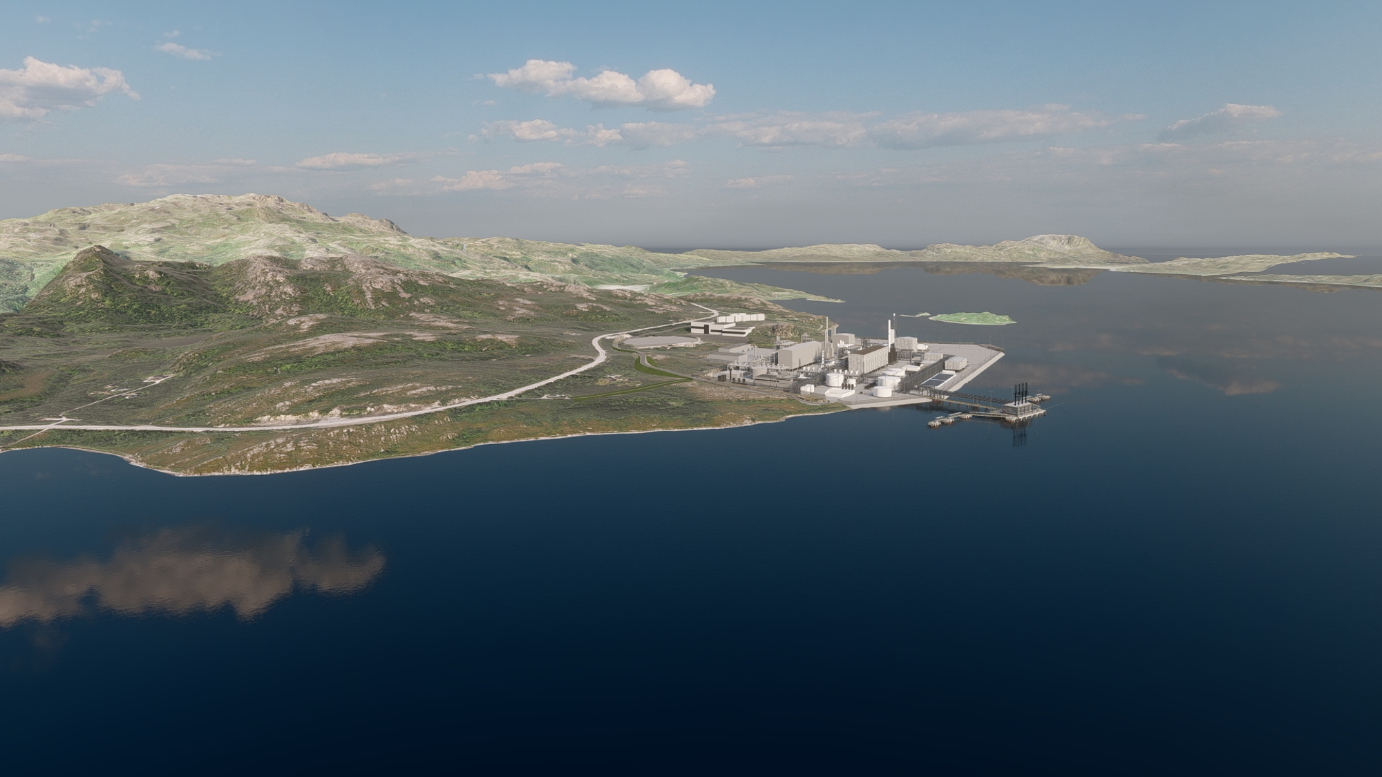
Why now?
Macrodrivers
Grid capacity in Europe is fully constrained due to electrification agenda, datacenter and AI/hyperscale growth, and large demand growth in industry the last 10 years.
Decarbonization is fully back on the agenda after the recent power and gas crisis, France, Germany and others are restating their intention and strengthening efforts, including existing 190 million tons of annual ammonia use.
Energy security is key in the new environment, and demand for fuel-based power is increasing rapidly, with OEMs seeing order books for fuel-based power equipment filling up for the next five years. New ammonia uses in shipping, power, mobility and industry, estimated at 200 million tons in 2050¹⁾.
Clean ammonia at scale is a differentiator in this new energy reality, providing unprecedented baseload and back-up energy security
1) Source: S&P Global 2026
Notes:
Energy security​
AI power demand​
Decarbonization​
Hovedbudskap: Makrodriverne er sterkere enn noen gang.
Anbefaling: Koble energi, AI og dekarbonisering til etterspørsel etter ammoniakk.
Visualisering: Infografikk med 3 drivere.

Slide 5



Europe’s only FEED-ready low-carbon ammonia megaproject
Barents Clean Ammonia asset
Unique combination of scale, maturity and location
Location: Northern Norway - supporting European security of supply.
Technical: Proven technology with globally recognized partners.
Gas supply: Access to favorably priced gas with very low life cycle emissions, combined with abundant access to fresh water.
World scale production: 1 million tons of annual ammonia production, equal to 5170 GWh of energy
Storages: 120,000 m³ ammonia storage providing security of supply and energy price optimization, equal to 420 GWh of energy storage.
Power: Renewable electricity from grid secured: 45 MW.
Emissions: CO₂ capture rate >99 %, storage of ~2 mill t/y. Market leading carbon footprint.
Barents Clean Ammonia
Company HQ
2027/28
Final investment decision
End 2031
Est. production start
1mill. tons *
Annual production at plateau
Notes:
4. Europe’s Only FEED-Ready Low Carbon Ammonia Megaproject
Unique combination of scale, maturity and location​
Hovedbudskap: Unik kombinasjon av størrelse, modenhet og lokasjon.
Anbefaling: Positioner prosjektet mot alternative prosjekter.
Visualisering: Kart og nøkkeltall.

Slide 6
90% of critical project work completed
Derisking
Gas supply signed
CO₂ transport and storage signed
Ammonia offtake signed
Land option for industry zoned area secured
Grid capacity secured
Fresh water supply secured
FEED and EPC option negotiated
Technology licensing and engineering negotiated
Technical designs frozen and FEED ready
Planning program approved
Impact assessments 80-90% complete
Site survey and pipeline surveys completed
Project 90% derisked and ready for start of FEED work and moving towards financial close
Note: Commercial agreements are non-binding at this stage

Slide 7
Initial commercial validation concluded
Ammonia offtake
Progressing towards sales target
Ammonia sales target: 850 mtpa under long-term agreements
The remaining volumes on other contract formats including short-term, spot and back-up power
Target buyers that have the financial and operational strength to support major volumes and long-term commitments
Counterparties | Quantities | Status | Next Step
European Energy group | 200-300,000 t/year | Signed term-sheet *) | Binding agreement
European Energy group | 200-500,000 t/year | Active term-sheet discussions | Signed term-sheet *)
Industrial company | 100-300,000 t/year | Term-sheet exchanged | Term-sheet negotiations
European Energy group, Energy trader | 400-450,000 t/year | Pricing principles exchanged | Term-sheet negotiations
Data centers | TBD | Early phase engagement | Exchange term-sheets
*) Non-binding term-sheet
Notes:
Commercial Validation Already Established​
Signed term sheets and negotiations​
Hovedbudskap: Markedet er allerede i ferd med å bli sikret.
Anbefaling: Vis term sheets, forhandlinger og volum.
Visualisering: Kommersiell trakt eller volumdiagram.

Slide 8
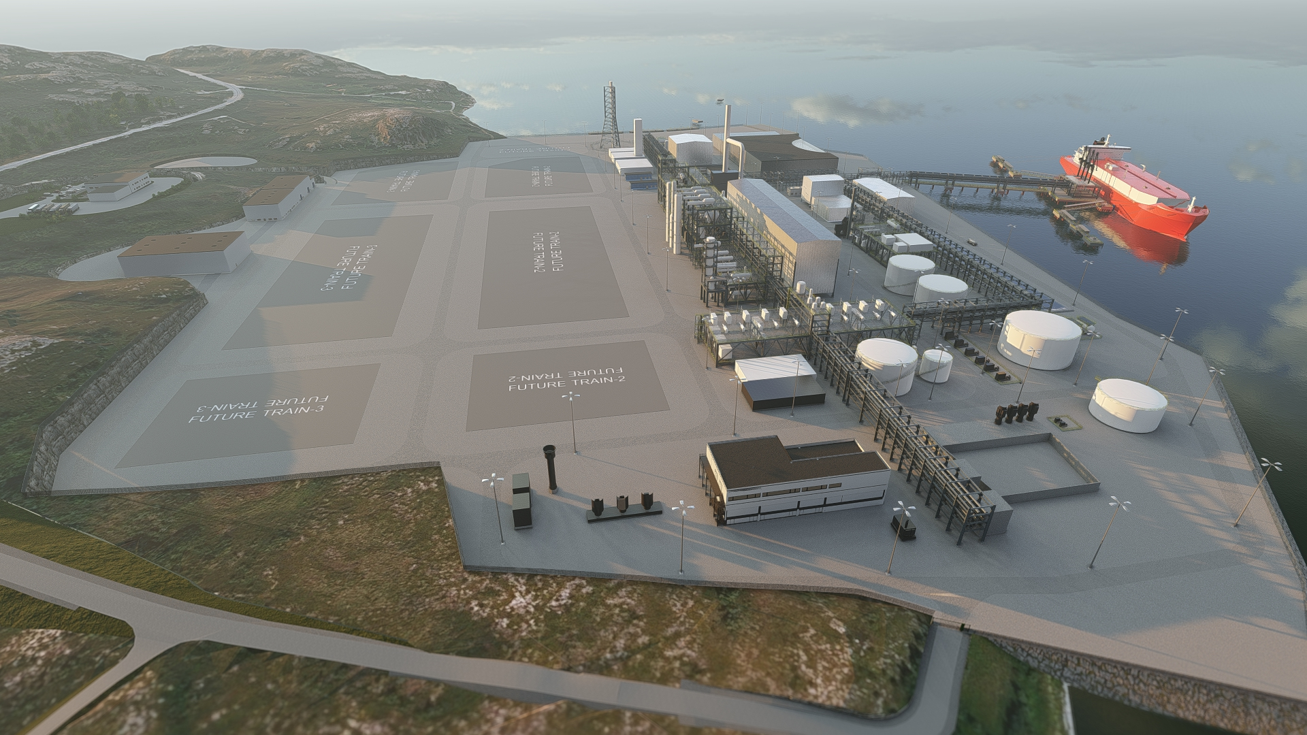
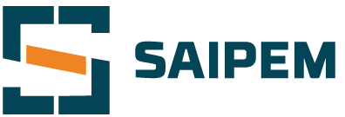
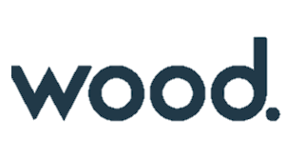
Partners
Tier-1 partners derisking the ammonia project
Barents Blue, is focusing on delivering world class clean energy assets with globally leading tier-1 partners
Topsoe is the selected technology partner delivering the SynCORTM Ammonia technology, having decades of ammonia experience
Saipem is the selected EPC partner with high-quality project execution and 40 years of experience with Topsoe ammonia technology
Wood Group is the owners engineering partner with high level engineering quality, and has supported the project since 2021, derisking the engineering deliveries
Notes:
Tier-1 Partners
Topsoe, Saipem, Wood​
Hovedbudskap: Verdensledende partnere reduserer gjennomføringsrisiko.
Anbefaling: Forklar hvorfor partnerne betyr noe.
Visualisering: Logoer og roller.

Slide 9
Ecosystem matured and ready for FEED with clear path to FID
Ecosystem matured
Gas supply
Gas pipeline
Ammonia plant
CO₂ storage
Ammonia sales
Term sheet signed for 100% of the natural gas supply (long-term) with very low life cycle emissions
Modification solution for gas export established
Concept study and pipeline route survey performed for pipeline from gas plant to ammonia plant
Option agreement for land lease confirmed
Plant concept studies completed
Impact assessment program approved
Site survey and rock drilling performed
Reserved 45 MW from grid
Fresh water supply secured
FEED contract and EPC option negotiated
Term-sheet for transportation and storage of 100% of CO2 signed
CO₂ storage specification compliance verified
Term sheet signed for significant part of ammonia production (long-term)
Ammonia product compliant with EU Taxonomy and Delegated Act on Low Carbon Hydrogen
Notes:
5. 90% of Critical Project Work Completed Before FEED
Gas, CO2 storage, EPC, land, power, customers​
Hovedbudskap: Prosjektet er allerede betydelig av-risikert.
Anbefaling: Den viktigste risiko-sliden. Vis hva som allerede er på plass.
Visualisering: Checkliste med grønne avhukinger.

Slide 10
Project economics
Attractive economics
– Forecasted EBITDA in operational phase
Forecasted EBITDA- 100% BCA (MEUR) | 2032 | 2033 | 2034 | 2035 | 2036 | 2037
Revenue | 601 | 683 | 657 | 657 | 657 | 657
COGS | (178) | (210) | (210) | (210) | (210) | (210)
Gross profit | 423 | 474 | 447 | 447 | 447 | 447
OPEX ^{*)} | (115) | (115) | (115) | (115) | (115) | (115)
EBITDA | 308 | 359 | 333 | 333 | 333 | 333
Revenues:
            Sale of produced ammonia (individual sales by each owner or other sales arrangements dependent on commercial model)
  Sale of CO₂ free quotas (2032 - 2033)
  COGS:
  Gas purchase
  CO2 transport and storage
  OPEX:
  Plant operational cost (manning, maintenance, power consumption, insurances, etc)
    Based on current capex, revenues and costs estimates the project is expected to yield IRR higher than 10%
IRR > 10%
EBITDA >
300 EURM
Revenue >
600 EURM
Gross profit > 400 EURM
    ^{*)}Not incl. cost of leasing plant infrastructure from asset SPV. Duration and terms to be agreed.
Notes:
Attractive Economics
EBITDA > EUR300m​
IRR >10%​
Hovedbudskap: Prosjektet fungerer økonomisk.
Anbefaling: Forenkle finansslidene til få nøkkeltall.
Visualisering: Fire KPI-bokser.

Slide 11
NYSE listing through SPAC merger
IPO planned 2027
The company is planning an IPO to the New York Stock Exchange (NYSE) in 2027, Barents Blue is well prepared with about 1200 shareholders already registered in VPS
The process planned for is a SPAC¹ merger with an existing NYSE listed SPAC entity, that is already fully capitalized²
Several steps of the process are completed such as initial due diligence and signed letter of intent, but several steps remain:
                Signing and completion of the definitive agreements
                Existing SPAC shareholders approval
                Preparation of business combination prospectus (BCP)
                US Stock Exchange Committee (SEC) review and approval of BCP
                Execute SPAC merger and become a joint entity listed on NYSE
    As part of the SPAC merger all shareholders in Barents Blue will get shares in the new combined legal entity based upon the valuation of Barents Blue and the SPAC
    Following the listing, all shares will become tradable on NYSE
NYSE IPO a key company milestone in 2027
    1)Special Purpose Acquisition Company, made to be merged with an operational company.
    2) Sufficient funds in SPAC entity to finance FEED, some equity for CAPEX and inorganic growth through M&A
Notes:
10. NYSE listing

Slide 12
Invest prior to upcoming inflection points
Value creation roadmap
Key upcoming project & company milestones
NYSE IPO (SPAC merger complete)
Start-up of FEED work
Financial close
Start-up of execution work
Start-up of commercial operations
Participate in further derisking and value increases in upcoming milestones
2027
2028
2029
2030
2031
Timeline
Notes:
Value Creation Roadmap​
SLIP > FEED > FID > IPO > Operations​
Hovedbudskap: Verdiskaping kommer før produksjon.
Anbefaling: Vis FEED, FID og IPO som verdidrivere.
Visualisering: Tidslinje.

Slide 13
Why invest through a SLIP today?
Investment Thesis
The investment through a SLIP secures the investor a 25% rebate on the share price in the planned IPO, ahead of key upcoming milestones
The SLIP is a financial instrument that provides the investor with shares in an upcoming equity event where the share premium is paid today, and where the nominal share price of 0.05 NOK/share is paid just prior to the issuing of the shares
As part of completion of the process leading up to the contemplated SPAC merger and subsequently the corresponding IPO, the shares will be issued to the SLIP investors immediately prior to completion
Notes:
10. Why Invest Through a SLIP Today?
Invest before next valuation step​
Hovedbudskap: Kom inn før neste verdivurdering.
Anbefaling: Forklar SAFE/SLIP enkelt og investorvennlig.
Visualisering: Illustrasjon av konvertering.

Slide 14
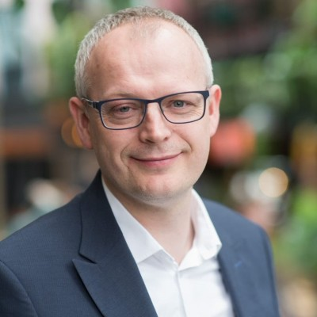
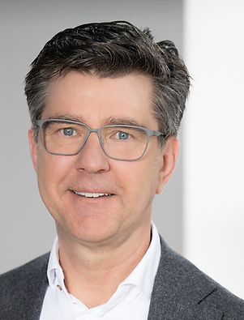
Experienced team with proven track record
The Team
Highly experienced and complementary team with extensive international expertise across the energy value chain. The team combines proven capabilities project development, financing, negotiations and business development, with deep technical and operational expertise in hydrogen, ammonia, gas, CCS, data centers, power-as-a-service, and industrial energy projects.
Board of Directors
Management Team
Chief Executive Officer: | Finn R. Almås | 30+ years in ammonia mega projects
Finance Director: | Kjetil Stødle | 20+ years in energy finance
Commercial Director: | Øyvind Kristian Skovlund | 30+ years in long-term commercial agreements
Capital Markets Director: | Matyas Kolsofszki | 15+ years in capital markets and start-ups
Project Director: | Kristian Magnus Jensen | 30+ years in mega projects incl ammonia
Advisory Board Member: | Thor Magnus Rovik | 25+ years in energy and infrastructure industries
Advisory Board Member: | Jan Kurrelvink (TBC) | 25+ years in global power markets
Bjørgulf has a proven track record of company building, IPO and capital raising. 8 years of CEO and founder experience, 15 years prior experience of management experience in the energy industry.
Chair of the Board and Founder
Bjørgulf Haukelidsæter Eidesen
Rob has held global roles in Yara, operations management and VP of technology. In Topsoe as thought leader for clean ammonia. Board director and president of the Ammonia Energy Association, and other key ammonia industry roles.
Board Member
Rob Matheus M. Stevens
Board Member
Rob Matheus M. Stevens
Notes:
Experienced Team With Proven Track Record​
Leadership, ammonia, CCS, capital markets​
Hovedbudskap: Teamet kan gjennomføre.
Anbefaling: Kortfattet fokus på track record og kompetanse.
Visualisering: Portretter og 2-3 linjer per person.

Slide 15
Use of Proceeds
Use of Proceeds
Capital runway
  The company plans to raise capital for a 12-month runway, to complete IPO process, preparations for FEED start-up, continue maturation of commercial agreements and key hires.
Capitalization plan
  The company’s capitalization plan includes achieving key value creation milestones such as executing FEED, IPO and preparing for financial close
    FEED studies, commercial agreements, IPO, project financing and Increased project manning
Exit planning for investors
  Barents Blue is well prepared and set-up for making an IPO. The timing of the IPO is planned to be after Barents Clean Ammonia start of FEED in first half of 2027.
Key milestones
Oct 2026 | Invitation and opening of SLIP round
Oct 2026 | Webcast
Oct/Nov 2026 | SLIP execution
Nov 2026 | Closing SLIP round
Q1 2027 | Completing SPAC merger and IPO
Q1 2027 | Kick-off FEED works
Notes:
Use of Proceeds
FEED, financing, commercial agreements, team​. Maximise value increase leading up to listing.
Hovedbudskap: Kapitalen brukes til verdiskapende milepæler.
Anbefaling: Knytt kapitalbruk direkte til verdiskaping.
Visualisering: Sirkeldiagram eller milestone-grafikk.

Slide 16
SLIP transaction summary
Transaction summary
Timeline and key considerations
The offer | Private placement of approximately NOK 38.5 million through investment through SLIP agreements (“SLIP investment”) in Barents Blue AS (the “Company” or the “Issuer”), (the “Private Placement”) in two tranches, Trance A and Trache B, where the Tranche B is targeted to smaller shareholders and limited to 8.5 MNOK and where Tranche A is targeted towards professional investors and limited to 38.5 MNOK – the investments under Trance B.
Minimum and maximum investment | Minimum investment of NOK 50,000 and maximum 750,000 NOK per SLIP Investment in Trance B, and minimum investment of NOK equivalent of 100,000 Euro in Trance A.
Use of proceeds | Expand organization and working capital to perform IPO through a SPAC merger, ammonia project activities General corporate purposes
Cornerstone investors | TBD
Allocation criteria | The allocation will be made on a first come first served basis, and subsequently at the sole discretion of the Company’s board of directors (the “Board”) The Board expects to focus on criteria such as (but not limited to) size and timeliness of order, perceived investor quality, investment horizon and shareholder base following SLIP conversion
Investor requirement | VPS account or nominee account holder at the time of SLIP conversion
Minimum application | Minimum investment and allocation of NOK equivalent of EUR 100,000 for Trance A, and minimum investment and allocation of NOK 50,000 and maximum investment and allocation of NOK 750,000 for Trache B
Listing | Following the Private Placement, the Company intend to apply for its shares to be admitted to trading on New York Stock Exchange through a SPAC merger, or alternatively to another stock exchange, expected H1 2027.
Timeline | Start of application period: 8 Oct 2026 at 16:30 CET Close of application period: 19 Nov 2026 at 16:30 CET Payment for the Private Placement: to performed within two weeks following signing of SLIP agreement. Completion of SPAC merger and issuing of SLIP shares: Expected Q1 2027
Conditions | Completion of the Private Placement is subject to: (i) all corporate resolutions of the Company required to implement the Private Placement being validly made, including the Board’s resolution to proceed with the Private Placement, (ii) the Company’s assessment that a National Prospectus is not required.
Other | Some details may change during the process
Notes:
SLIP Transaction Summary​
EUR 10m raise via SLIP​
Hovedbudskap: Enkel oversikt over investeringsvilkår.
Anbefaling: Reduser juridisk tekst og fokuser på økonomiske punkter.
Visualisering: Term-sheet layout.

Slide 17
SLIP investment highlights
90% derisking & FEED ready project
Most of the derisking already performed, project ready to proceed towards financial close.
The only world-scale low carbon ammonia asset in Europe, EBITDA above EUR 300 million.
Financial close planned in Q4 27¹/Q1 28, key milestone and strong value driver.
Commercially advanced and well-positioned
Commercial agreements signed² at priced term-sheet level, offering a well documented and attractive business case, with access to favorable natural gas pricing.
Asset closeness to premium EU market providing an excellent commercial position.
Fully established eco-system with tier-1 partners
Globally recognized tier-1 partners in all parts of the business ecosystem, derisking the project and providing a high-quality opportunity all over.
Ecosystem matured since 2020 offering a mature and a high-quality value chain.
Key inflection milestones expected within 14-18 mnts
Start of FEED, IPO and Financial close, 3 key value inflections, all within 14-18 months
Barents Clean Ammonia offers attractive returns with IRR above 10% on the 100% project.
EUR 44 million in grant already awarded, EUR 9 million to be used in before financial close.
NYSE listing through SPAC merger exp within 4-8 mnts
Process towards listing through a SPAC merger on the New York Stock Exchange (NYSE) well underway. Expected to be completed in about 4-8 months.
SPAC merger will ensure FEED financing and provide M&A capacity for inorganic growth.
1: Potential for advancing FID to Q4/2027
2: Non-binding
Notes:
FEED-ready project​
World-scale asset​
Tier-1 partners​
Commercial traction​
Multiple liquidity routes​
Hovedbudskap: Fem grunner til å investere nå.
Anbefaling: Oppsummer hele caset på én side.
Visualisering: Ikoner og korte punkter.

Slide 18
Investment opportunity summary
The investment opportunity
The key aspects of the SLIP investment opportunity are:
      Unique project opportunity in Europe already 90% derisked
      Invest before upcoming key milestones in the value creation roadmap
      IPO planned in H1 2027 onto NYSE through a SPAC merger, participate with a rebated share price
      Company to build a portfolio of projects, based on the BCA¹ blueprint
    1) Barents Clean Ammonia.
Notes:
Graphics – established 2020, located in Oslo and Stavanger, project location Hammerfest,

Slide 19

Mission statement
Bridging the gap to a carbon neutral future
www.barentsblue.no

Slide 20
Share information slide

Slide 21
Energy Security at Scale for Europe's Digital Future
Clean energy for datacenters
Beyond the Grid: Clean Ammonia for Hyperscale Data Centers
Solves a key AI challenge: Provides reliable, low-carbon energy for AI and hyperscale data centers
Ammonia as an energy platform: Enables large-scale energy storage, transport, and dispatchable power, offering energy security and greater grid independence.
Major production capacity: Creating a substantial strategic energy reserve of 5,170 GWh annually.
Exceptional storage resilience: Storage capacity equivalent to 418 GWh provides long-term energy security.
  Datacenter capacity is scaling rapidly driving demand for power
  Power availability increasingly dictates site selection
  Data centre customers increasingly require sustainably power due to CSR commitments
With core markets grid constrained, data center scaling increasingly dependant upon new sustainable energy solutions

Slide 22
Barents Clean Ammonia - FEED and Project financing from several capital sources
FEED and Project Financing
Sources FEED financing (100%):
Sources FID financing (100%):
 | MEUR
Contributions by owners in Barents Clean Ammonia | 28
In-kind contributions from Topsoe and Saipem | 2
Awarded IPCEI grant (part of Enova support) | 9
Sum FEED financing | 39
 | MEUR
Infrastructure capital | 2,000
Awarded state aid from Enova, IPCEI grant | 35
Equity from BCA or additional state aid | 60
Debt financing on BCA owner equity | 205
Sum FID financing | 2,300
Total FEED budget for all equity partners in BCA EUR 39 million, the first part of the FEED until DG2 has a budget of EUR 10 million
The expected proceeds from the SPAC merger will ensure Barents Blue has sufficient capital to fund the FEED cost (EUR 28 million)
Total investment at FID of EUR 2.3 billion (excl. ASU and CO2 facilities)
Assumed a lease of the air separation unit (ASU) and CO2 facilities
~90% of investment at FID from infrastructure investor
Debt added on top of equity from BCA owners and the state aid from Enova
Potential export credit agency guarantees (eligible project)
Plan to apply for Innovation Fund support in 2026/2027 round - potential grant amount +/- 200 MEUR

